Slide 1

Privilege 101
We don’t talk about Bruno (to third parties), no, no, no!

Slide 3
Privilege 101
Is it privileged or is it simply business advice? Decrypting attorney-client privilege.
Work product: What does “in anticipation of litigation” mean anyway?
Preempting production pitfalls and other ways privilege can deter discovery disputes.
The future is now: AI effects on privilege
Q&A

Slide 4
Is it privileged or is it simply business advice? Decrypting attorney-client privilege

Slide 5
Attorney-Client Privilege
Texas Rules of Evidence 503
A client has a privilege to refuse to disclose and to prevent any other person from disclosing confidential communications made to facilitate the rendition of professional legal services…
Tex. R. Evid. 503(b)(1)

Slide 6

Attorney-Client Privilege
Texas Rules of Evidence 503

Slide 7
Attorney-Client Privilege
Texas Rules of Evidence 503
Who is a client?
A person, public officer, or corporation, association, or other organization or entity that either
      is rendered professional legal services by a lawyer; or
      consults a lawyer with a view to obtaining professional services from the lawyer
Tex. R. Evid. 503(a)(1)

Slide 8
Attorney-Client Privilege
Texas Rules of Evidence 503
Who is a client? Corporate Issues
Two major tests:
Control Group (restrictive approach)
Subject Matter (more liberal/realistic)

Slide 9
Attorney-Client Privilege
Texas Rules of Evidence 503
Control Group
Restrictive approach
The corporation is the “client” and only employees who have authority to act on counsel’s advice are those that can “personify” the corporation. See e.g., City of Philadelphia v. Westinghouse Elec. Corp., 210 F. Supp. 483, 485 (E.D. Pa. 1962).

Slide 10
Attorney-Client Privilege
Texas Rules of Evidence 503
Subject Matter
Liberal/realistic approach
Acknowledges that low and mid-level employees often possess the most relevant information when a legal issue arises and extends the attorney-client relationship beyond corporate management, so that it can potentially apply to communications with any corporate employee. Upjohn v. US, 449 U.S. 383 (1981).
Texas follows this test. See In re E.I. DuPont de Nemours & Co., 136 S.W.3d 218, 226 (Tex. 2004).

Slide 11
Differentiating Business and Litigation Advice
What is the predominant purpose of the communication?
“In light of the two hats often worn by in-house lawyers, communications between a corporation’s employees and its in-house counsel … must be scrutinized carefully to determine whether the predominant purpose of the communication was to convey business advice and information, or, alternatively, to obtain or provide legal advice.” Brown v. Barnes & Noble, Inc., 474 F. Supp. 3d 637, 648 (S.D.N.Y. 2019).

Slide 12
Ways to Lose Privilege
Legal advice is entwined with/superseded by business advice
Counsel’s involvement in a matter is illusory
Disclosure to employees who don’t need to know
Disclosure to third parties

Slide 13
Attorney-Client Privilege
Texas Rules of Evidence 503
When is a communication confidential?
A communication is “confidential” if not intended to be disclosed to third persons other than those
      to whom disclosure is made to further the rendition of professional legal services to the client; or
      reasonably necessary to transmit the communication.
Tex. R. Evid. 503(a)(5)

Slide 14

Attorney-Client Privilege
Texas Rules of Evidence 503

Slide 15
Attorney-Client Privilege
Texas Rules of Evidence 503
When is a communication made to facilitate the rendition of legal services?
A client’s communication requesting services from an attorney
A client’s communication expressing facts and seeking the attorney’s advice.
An attorney’s communication to the client expressing legal advice.
In-house counsel’s confidential communications with corporate employees to prepare for litigation.

Slide 16
Rules of Professional Conduct
Rule 1.05: Confidentiality of Information
Generally, a lawyer shall not knowingly reveal confidential information of a client or a former client to:
A person that the client has instructed is not to receive the information; or
Anyone else, other than the client, the client’s representatives, or the members, associates, or employees of the lawyer’s law firm.

Slide 17
Rules of Professional Conduct
***Exceptions***
Express/implied authorization to carry out representation
If necessary to do so to comply with a court order
To the extent reasonably necessary to enforce claim/establish defense in a controversy between lawyer and client
To prevent client from committing a criminal act

Slide 18
Case Study
University of Texas v. Franklin Center for Government and Public Integrity
Issue:
Whether documents underlying an investigation into allegations of undue influence in UT’s admission’s process are protected by the attorney-client privilege.

Slide 19
Case Study
University of Texas v. Franklin Center for Government and Public Integrity
UT hired outside firm to investigate allegations of improper admissions practices at UT.
During its investigation, Kroll obtained thousands of documents from UT and interviewed relevant individuals.
Public Information Act request for documents that were either provided to investigator by UT or created by investigator during its investigation.
Notes:
UT argued that all the documents were protected by the attorney–client privilege because investigator was serving as its “lawyer’s representative”.

Slide 20
Case Study
University of Texas v. Franklin Center for Government and Public Integrity
Kroll acted under authority of counsel/as lawyer’s representative. Tex. R. Evid. 503(a)(4)(A).
      Rendition of professional legal services must be a “significant purpose” for the retention.
    Publication of Kroll report did not constitute wholesale waiver.
      May constitute waiver as to some documents where “substantial part” of document was revealed.

Slide 21
Work product: What does “in anticipation of litigation” mean anyway?

Slide 22

Work Product
Texas Rule of Civil Procedure 192.5

Slide 23
Work Product
Texas Rule of Civil Procedure 192.5
Work product comprises:
Material prepared or mental impressions developed in anticipation of litigation or for trial by or for a party or a party's representatives, including the party's attorneys, consultants, sureties, indemnitors, insurers, employees, or agents; or
A communication made in anticipation of litigation or for trial between a party and the party's representatives or among a party's representatives, including the party's attorneys, consultants, sureties, indemnitors, insurers, employees, or agents.
Tex. R. Civ. P. 192.5(a)

Slide 24
Who can create Work Product?
A party
A party’s attorney
Party and attorney representatives, including:
      Consultants
      Experts
      Indemnitors
      Insurers
      Employees
Tex. R. Civ. P. 192.5(a)(1)

Slide 25
Core v. Non-Core Work Product
Core Work Product
Materials containing attorneys’
Mental impressions
Opinions
Conclusions
Legal theories
Entitled to absolute protection.

Slide 26
Core v. Non-Core Work Product
Non-Core Work Product
All other work product.
An attorney’s settlement division worksheet
Fact details of an attorney’s phone conversation with a third party
An attorney’s compilation of information (even where disclosure may reveal the attorney’s mental processes
Entitled to qualified protections—the court may order its disclosure under certain circumstances.

Slide 27
Work product:
What does “in anticipation of litigation” mean anyway?
A party seeking protection must establish two elements:
A reasonable person would have concluded from the totality of the circumstances that there was a substantial chance of litigation.
The party resisting discovery had a good faith belief that there was a substantial chance of litigation and performed the work or investigation for the purpose of preparing for the litigation.

Slide 28
Work product:
What does “in anticipation of litigation” mean anyway?
A reasonable person would have concluded from the totality of the circumstances that there was a substantial chance of litigation.
Examples:
A cease-and-desist letter
A serious accident
A demand for payment of a lawful debt
A letter of representation from opposing counsel
“Litigation” encompasses civil and criminal judicial proceedings, arbitration, and administrative proceedings.

Slide 29
Work product:
What does “in anticipation of litigation” mean anyway?
The party resisting discovery had a good faith belief that there was a substantial chance of litigation and performed the work or investigation for the purpose of preparing for the litigation.
Generally, does not protect materials that were created solely:
In the ordinary course of business
In response to an external or internal requirement

Slide 30
Materials Excluded from Protection
Historical facts
Preexisting documents
Facts regarding work product
Information discoverable under Rule 192.3
Trial exhibits

Slide 31
Materials Excluded from Protection
Contact information of any potential party or any person with knowledge of relevant facts
Photographs or electronic image that depicts underlying facts or that a part intends to offer into evidence
Any work product falling within Rule 503(d)
Any materials provided to a testifying expert
Witness statements

Slide 32
Preempting production pitfalls and other ways privilege can deter discovery disputes

Slide 33
Waving Goodbye to Privilege
Courts determine whether a party has waived a privilege by examining the type of disclosure.
Intentional
Inadvertent
Involuntary
Implied

Slide 34
Waving Goodbye to Privilege
A party may intentionally waive work product protection by voluntarily producing or disclosing work product to third parties outside
of the privilege.

Slide 35
Waving Goodbye to Privilege
A party's inadvertent or unintentional production or disclosure of privileged materials, even if voluntarily produced or disclosed, does not operate as a waiver if the producing party follows the "snap back" procedures set out in Texas Rule of Civil Procedure 193.3(d).
Notes:
Within ten days or a shorter time ordered by the court, after the producing party actually discovers that such production was made--the producing party amends the response, identifying the material or information produced and stating the privilege asserted. If the producing party thus amends the response to assert a privilege, any party who has obtained the specific material or information must promptly return the specified material or information and any copies pending any ruling by the court denying the privilege.

Slide 36
Waving Goodbye to Privilege
Disclosure is involuntary only if efforts reasonably calculated to prevent the disclosure were unavailing.
Privilege is waived if a party does not take reasonable precautions to prevent disclosure because “[i]nadvertent production is distinguishable from involuntary production. Granada Corp. v. Hon. First Ct. of App., 844 S.W.2d 223, 226 (Tex. 1992)

Slide 37
Waving Goodbye to Privilege
Implied waiver may occur when the privilege-holder puts an otherwise privileged communication into controversy.
See also “at issue” waiver, which occurs when a party uses the privilege offensively and puts the subject matter of their privileged communications at issue in litigation. Ginsberg v. Fifth Court of Appeals, 686 S.W.2d 105, 107 (Tex. 1985).

Slide 38
Preempting production pitfalls and other ways privilege can deter discovery disputes
Attorney-Client Privilege
Are the parties to the communication within the privilege?
Does the document itself qualify for privilege protection?
Does the document fall within an exception to the privilege?
Is the privilege waived?
Should the document be logged?

Slide 39
Preempting production pitfalls and other ways privilege can deter discovery disputes
Work Product Privilege
Are the creating parties within the privilege?
Does the document constitute work product?
What kind of work product is it?
Does the information fall within an exception to the privilege?
Has the privilege been waived?
Should the document be logged?

Slide 40
Preempting production pitfalls and other ways privilege can deter discovery disputes
Assertions of Privilege in Response to Requests for Production
Responding party asserts the privilege or protection in a withholding statement and withholds the privileged or protected material
      Must state that the responding party withheld information or material responsive to the request.
      Must identify the request to which the withheld information or materials relates.
      Must state the privileges or protections asserted
      Tex. R. Civ. P. 193.3(a)

Slide 41
Preempting production pitfalls and other ways privilege can deter discovery disputes
Assertions of Privilege in Response to Requests for Production
After receiving a withholding statement, the requesting party may ask the responding party to identify the withheld material or information.
The responding party must serve a response, typically in the form of a privilege log, within 15 days of the request.
      Tex. R. Civ. P. 193.3(b)

Slide 42
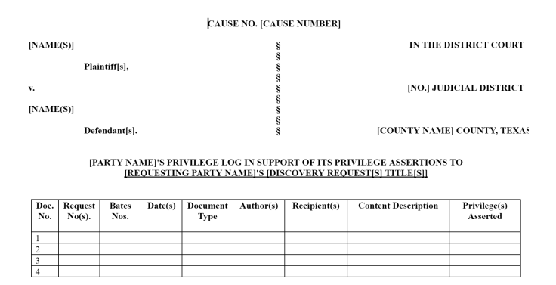
Preempting production pitfalls and other ways privilege can deter discovery disputes
Notes:
the withholding party must serve a response that:
(1) describes the information or materials withheld that, without revealing the privileged information itself or otherwise waiving the privilege, enables other parties to assess the applicability of the privilege, and
(2) asserts a specific privilege for each item or group of items withheld.

Slide 43
The future is now: AI effects on privilege

Slide 44
The future is now: AI effects on privilege
Beware revealing privileged information to open-source AI
Vet your AI tool:
      Licensing information
        Terms of Use
        Privacy Policies
        Frequently Asked Questions
    Consult with your client before using AI with your client’s confidential or privileged material, even internally

Slide 45
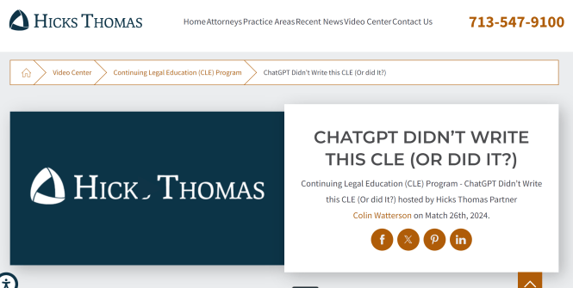
The future is now: AI effects on privilege
    Don’t forget to check out the recording of our colleague Colin’s CLE on the Hicks Thomas website
(https://www.hicks-thomas.com/video-center/continuing-legal-education-cle-program/)

Slide 46
Questions?
CLE: 174236172

Slide 47
Houston | Sacramento | Austin | Amarillo | Beaumont
Katherine Kunz
kkunz@hicks-thomas.com
Stacie Osborn
sosborn@hicks-thomas.com
www.hicks-thomas.com

